Slide 1

Fluids Review
Head loss, shear, vena contracta, and other concepts that enable a “smart fluids” design

Slide 2
Motivation
We will use smart use of physics and fluids to create elegant designs
Computer controlled flows and water levels in water treatment plants are
the lazy approach to design
Prone to failures (not a resilient design approach)
Example of flow distribution/control for filters

Slide 3
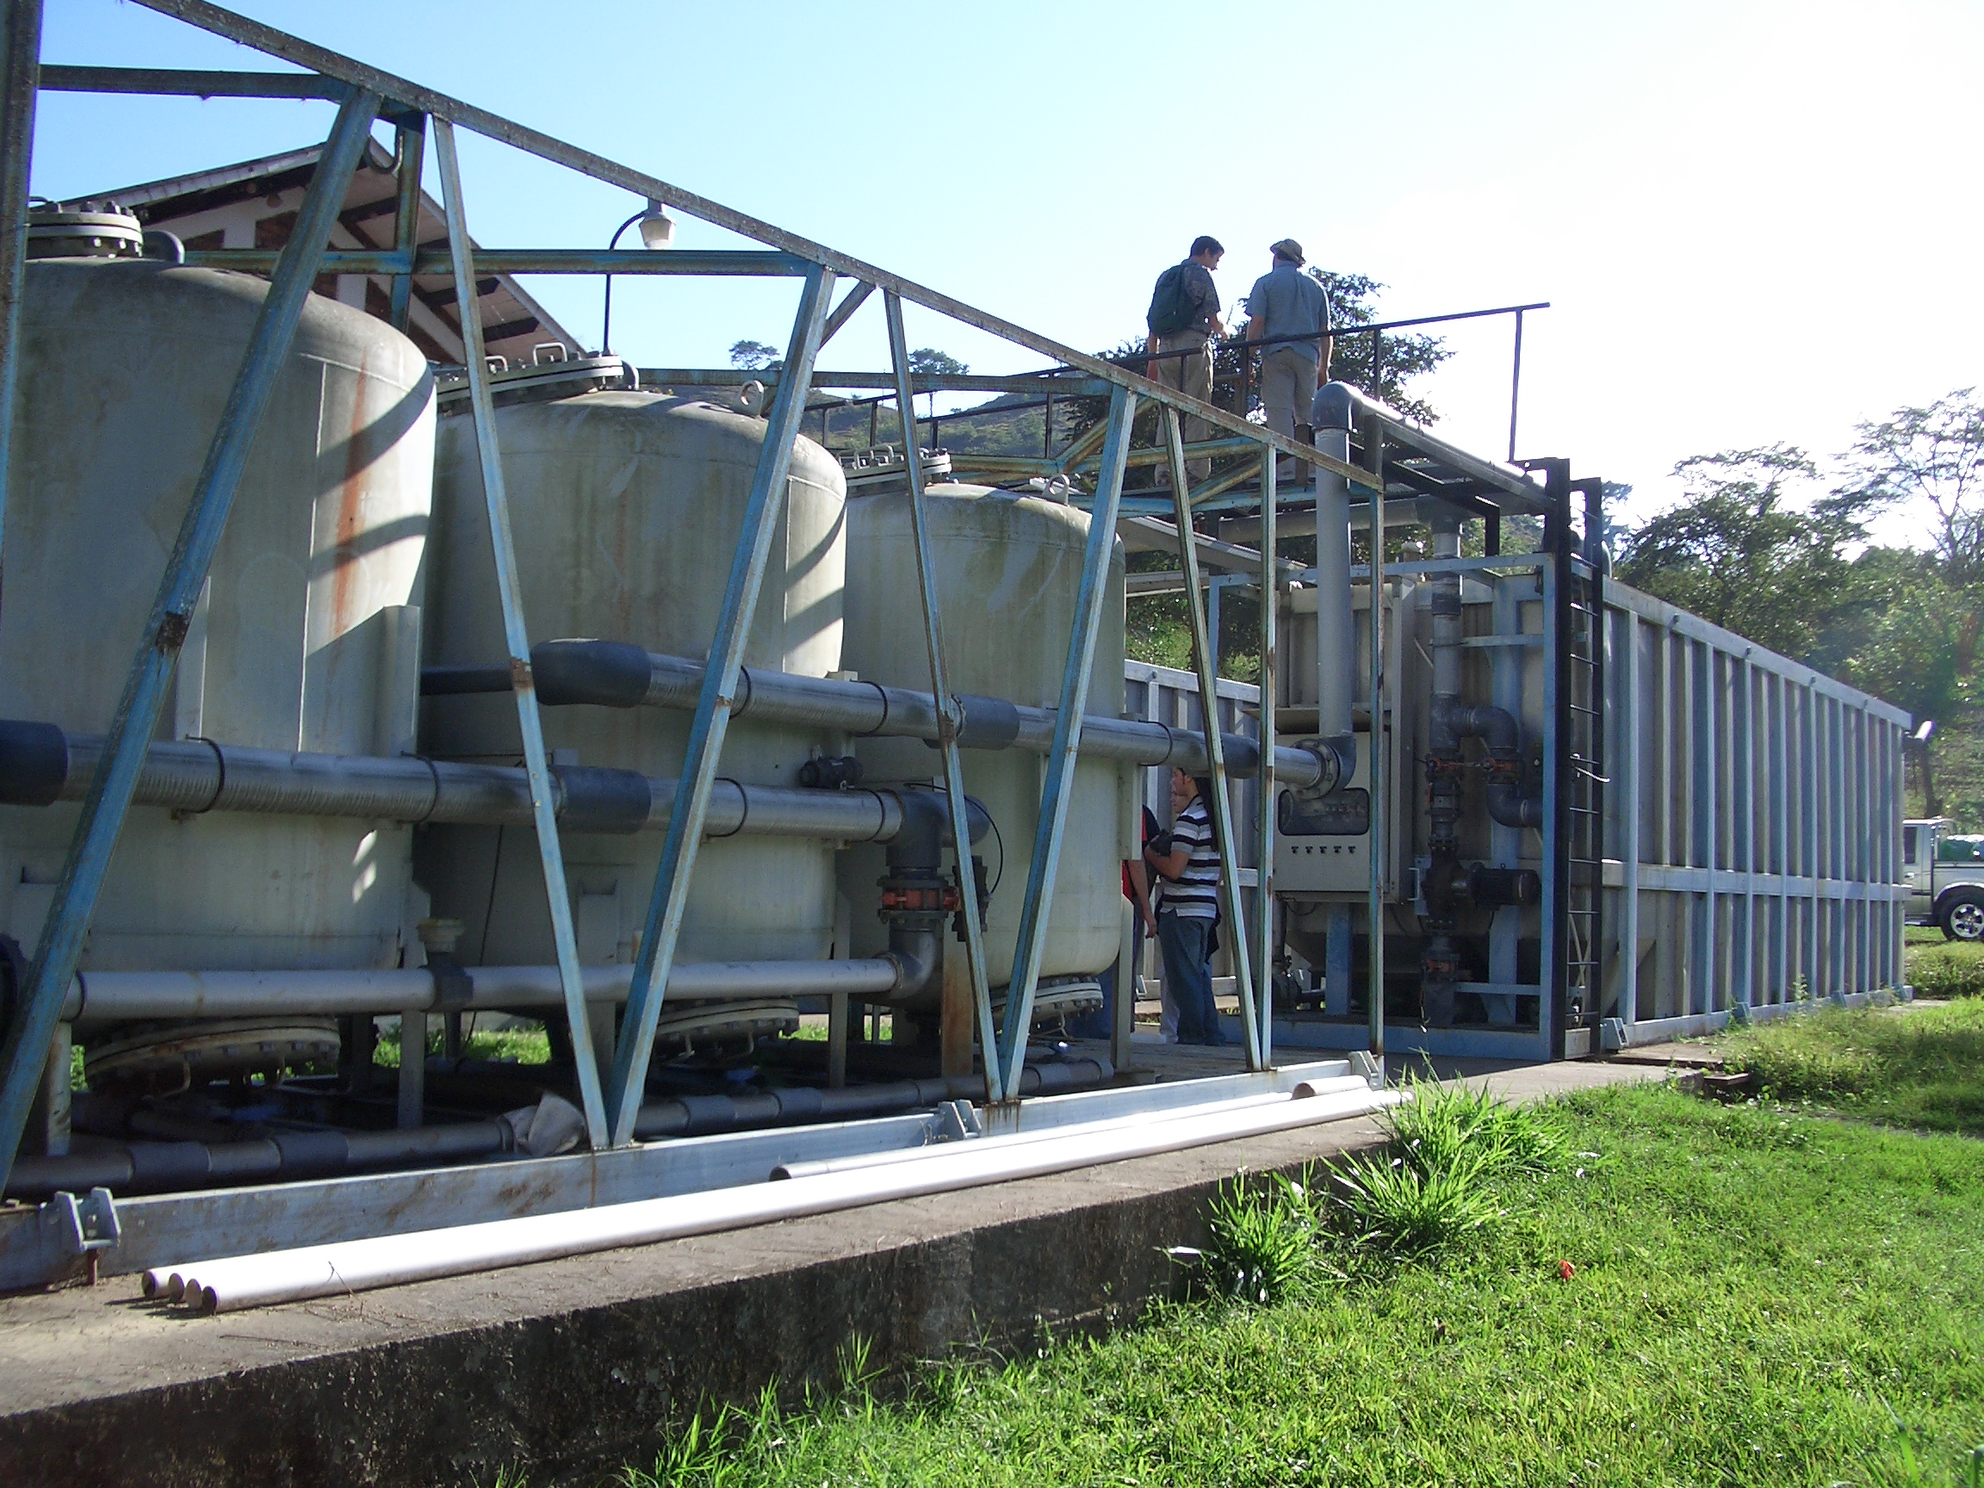
Dominant Design Constraint?
Notes:
What was the constraint used to create this design???? Constraints matter! The design you create will strongly reflect the constraints that you used to guide the design.

Slide 4
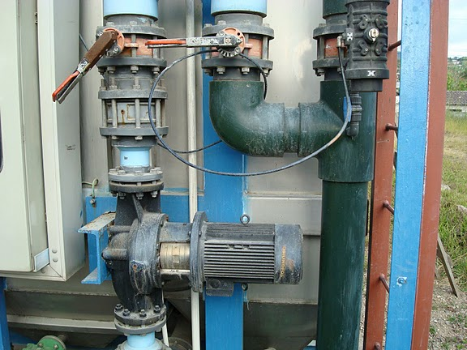

Slide 5

Failure to design for the Operator

Slide 6

Fluids Review
What causes drag?
Best orientation to reduce drag?

Slide 7
Streamlines
Draw the streamlines that begin on the upstream side of the object for these two cases
Which object has the larger wake?
Which object has the lower pressure in the wake? (if streamlines are bending hard at the point of separation, then the streamlines will be close together…)

Slide 8
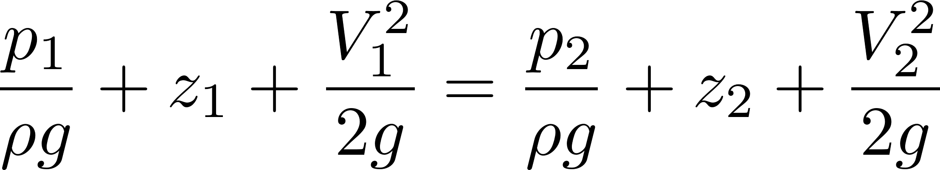
Why is there drag?
Fluid separates from solid body and forms a recirculation zone
Pressure in the recirculation zone must be low because velocity in the adjacent flowing fluid at the point of separation is high
Pressure in recirculation zone (the wake) is relatively constant because velocities in recirculation zone are low
Pressure behind object is low - DRAG

Slide 9
Fluids Review
Where should the luggage go?
Which equation for head loss?
Which process is inefficient?
Pipeline design

Slide 10
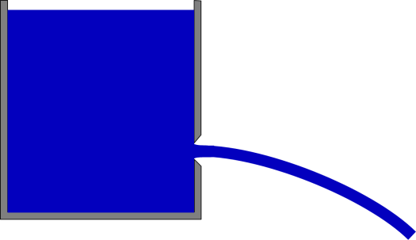
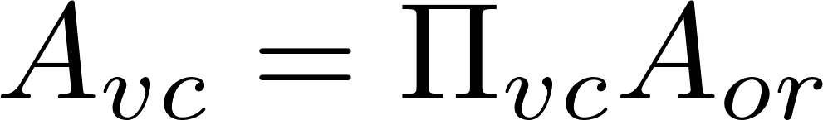
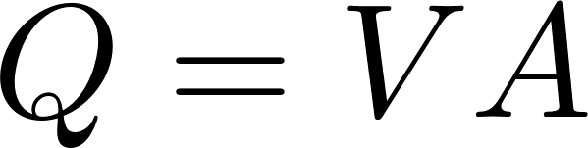

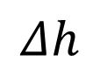
Orifice Equation
z₁
$$Δh$$
z₂ = 0
Flow contraction!
mechanical
Bernoulli equation (no energy loss)
^
Area of the constricted flow
Continuity equation
Orifice Equation (memorize this!)

Slide 11
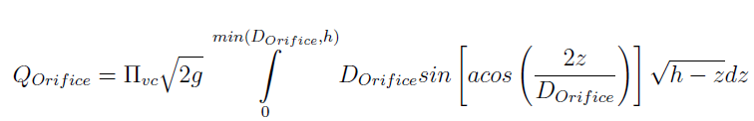
Orifice Equation
z₁
$$Δh$$
z₂ = 0
Flow contraction!
This equation applies to a horizontal orifice (so that the depth of submergence is constant throughout the entire orifice area). For depth of submergence larger than the diameter of the orifice this equation can be applied to vertical orifices. There is a general equation for vertical orifices in physchem.py within aide_design.

Slide 12
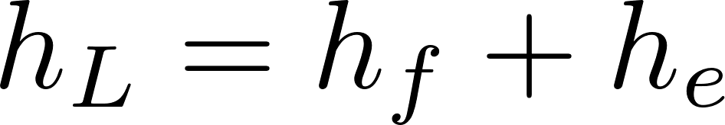
Two kinds of drag Two kinds of head loss
Drag (external flows)
Head loss (internal flows)
Skin (or shear) friction
Shear on solid surface
Classic example is flat plate
Form (or pressure) drag
Separation of streamlines from solid surface and wake results in a…
Flow expansion (behind object)
Major losses (h_{f} – friction)
Shear on solid surface
Shear on pipe walls
Minor losses (h_{e} – expansion)
Separation of streamlines from solid surface results in a…
Flow expansion
Energy equation (NOT THE BERNOULLI EQUATION)

Slide 13
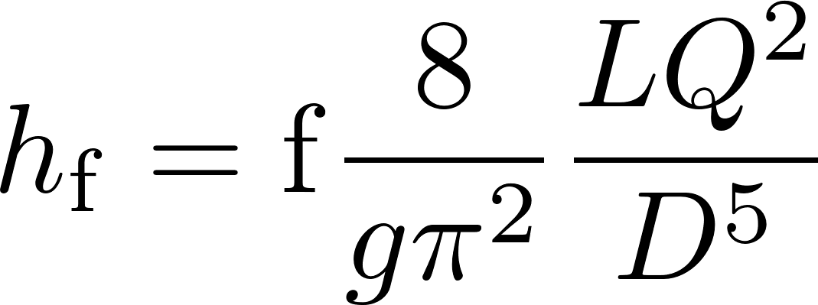
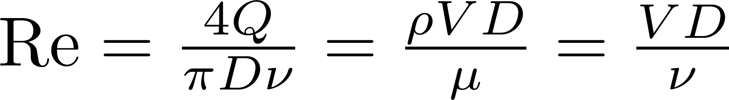
Head Loss in a Long STRAIGHT Tube (due to wall shear): Major Losses
Darcy Weisbach:
This equation gives the major losses for BOTH laminar and turbulent flow.
How to find the friction factor for wall shear, f?
First, find Reynold’s number
Transition from turbulent to laminar occurs at Re~2100

Slide 14
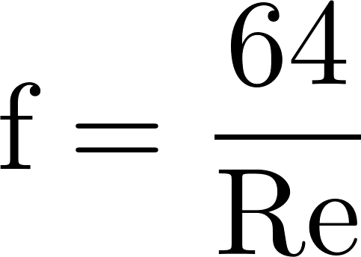
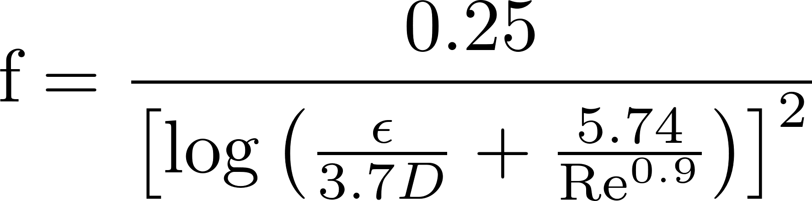

Head Loss in a Long STRAIGHT Tube (due to wall shear): Major Losses
Laminar
if Re < 2100,
Turbulent
if Re > 2100,
Swamee-Jain:
Major loss equation simplification
(for laminar flow only!):
Where Ɛ is the wall roughness
Hagen-Poiseuille:
(no h_{f} equation simplification😢)
h_{f} proportional flow

Slide 15
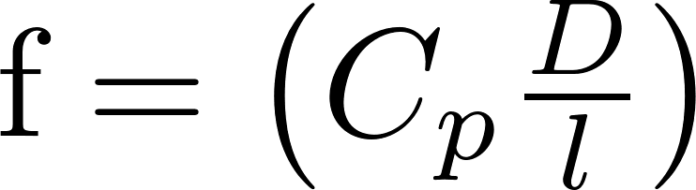
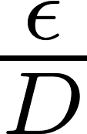
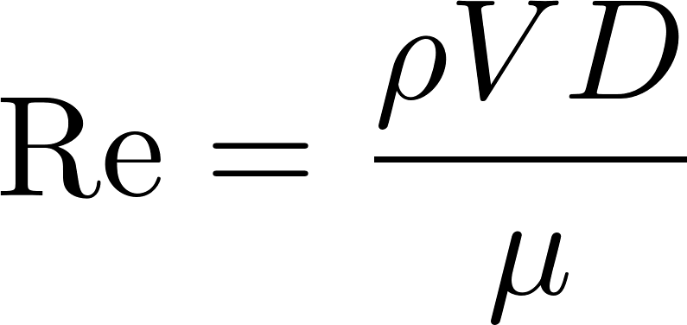
Frictional Losses in Straight Pipes: Moody Diagram
0.1
0.05
0.04
0.03
0.02
0.015
0.01
0.008
friction factor
0.006
0.004
laminar
0.002
0.001
0.0008
0.0004
0.0002
0.0001
0.01
0.00005
smooth
1E+03
1E+04
1E+05
1E+06
1E+07
1E+08
Re

Slide 16

Head Loss: Minor Losses
See extra 1
Head (or energy) loss (h_{L}) due to: outlets, inlets, bends, elbows, valves, pipe size changes
Losses are due to expansions
Losses can be minimized by gradual expansions
Minor Losses have the form where K_{e} is the loss coefficient and V is some characteristic velocity (could be contracted flow or expanded flow)
When V, KE  thermal

Slide 17
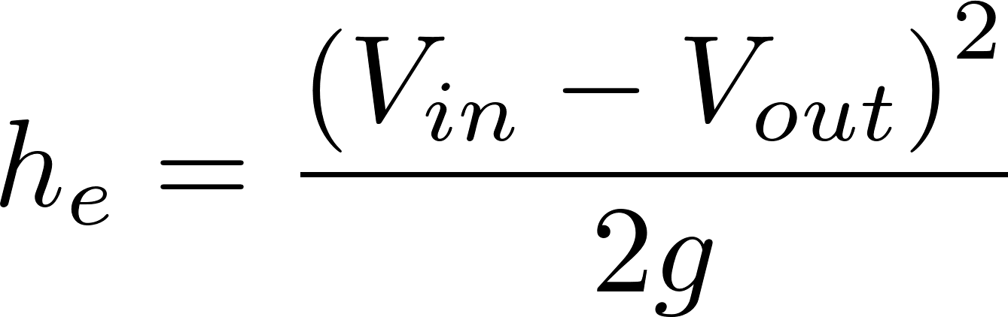
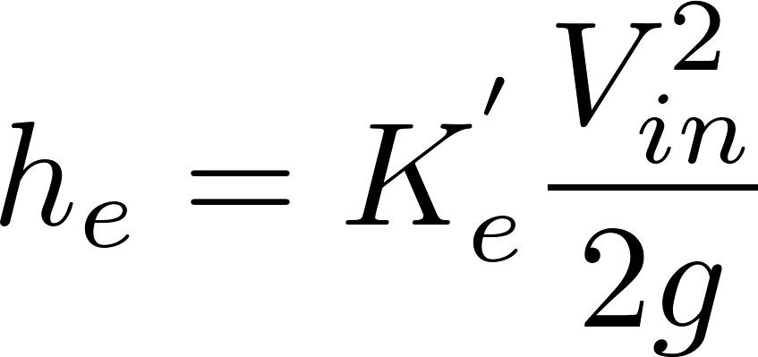
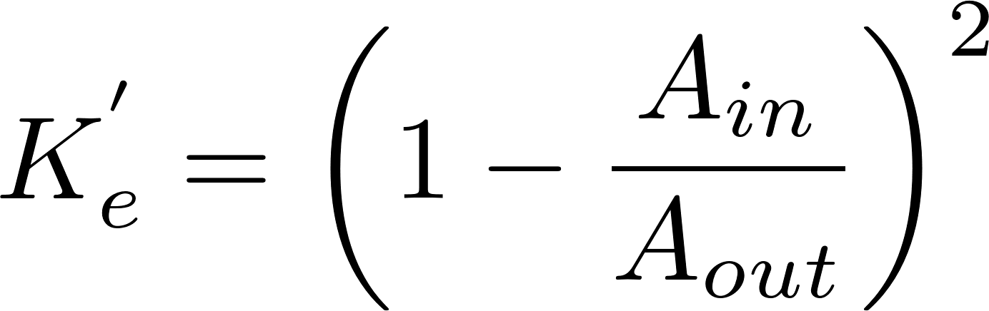
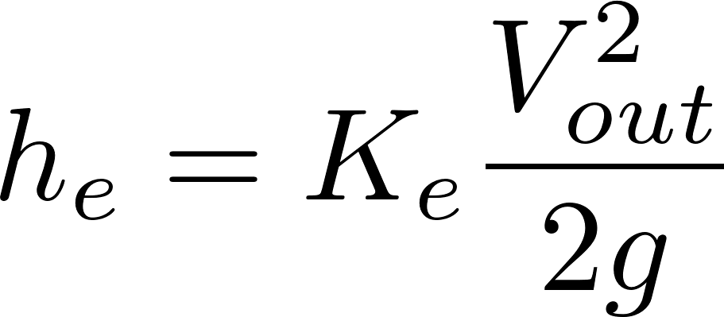
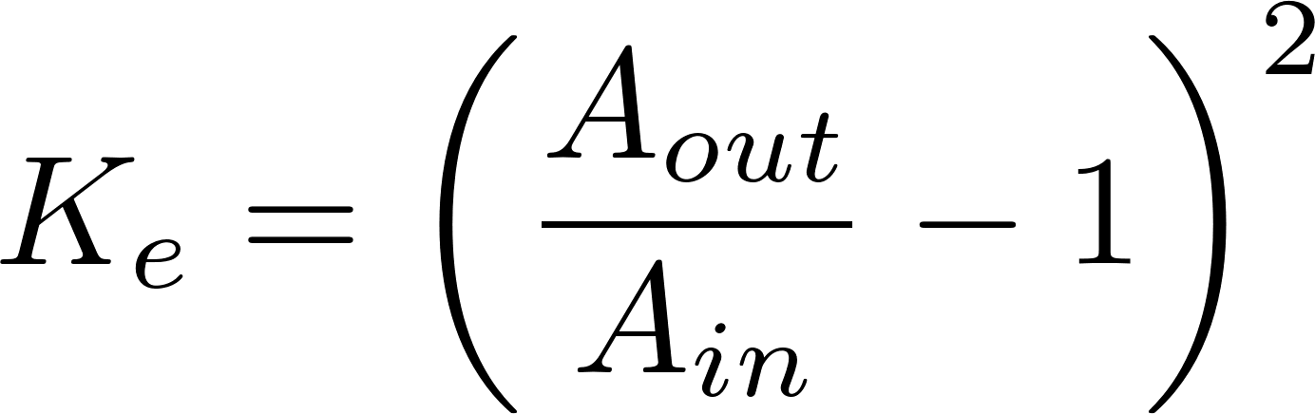
Three forms of Minor Loss equation
V_{in}
V_{out}
in
out
Most commonly used form
Notes:
Emphasize the minor loss coefficient is defined based on some relevant velocity. We can chose either V1 or V2. But the magnitude of the minor loss coefficient is determined by which velocity we use. We need to choose one and be consistent. The velocity that we choose will be a function of convenience. Minor losses are proportional to the square of the velocity. This is true whether the flow is turbulent or laminar!

Slide 18
Which points are `in` and `out` for finding the Minor Loss coefficient?
C
B
`in` should be where the flow is most compressed
A
`out` should be where the flow has fully expanded
Notes:
Draw the orifice case in detail showing expansion zone

Slide 19
Three forms of Minor Loss equation
V_{in}
V_{out}
in
out
Most commonly used form
Which form of velocity is easier to measure, V_{in} or V_{out}?
Which form of K can be greater than 1, K_{e} or K_{e}’?
What does it mean when K_{e} exceeds 1?
What is the K_{e} for a pipe discharging into a lake?
1
Notes:
Emphasize the minor loss coefficient is defined based on some relevant velocity. We can chose either V1 or V2. But the magnitude of the minor loss coefficient is determined by which velocity we use. We need to choose one and be consistent. The velocity that we choose will be a function of convenience. Minor losses are proportional to the square of the velocity. This is true whether the flow is turbulent or laminar!

Slide 20

Elevation difference = head loss trick
Also called the ‘head loss trick’ or ‘control volume trick
Small diameter tubing
This trick is used extensively in this class,
understanding it will make it easier to understand
future course concepts!
Notes:
Draw the orifice case in detail showing expansion zone

Slide 21
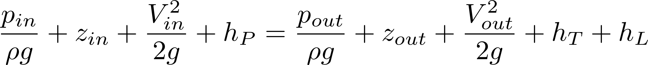
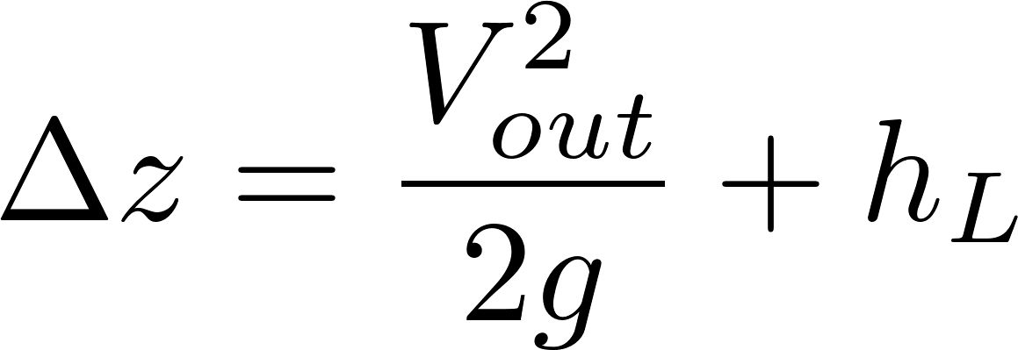
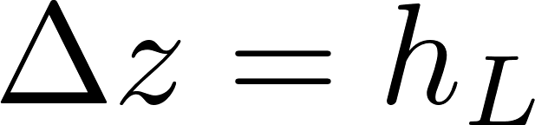
Elevation difference = head loss trick
Also called the ‘head loss trick’ or ‘control volume trick
Small diameter tubing
The kinetic energy term gets incorporated in head loss as a minor loss with a K_{e} of 1
Click here for a more in-depth explanation
Notes:
Draw the orifice case in detail showing expansion zone

Slide 22
How can you make water flow up through a tank (by gravity)?

